Slide 1

October

Slide 2
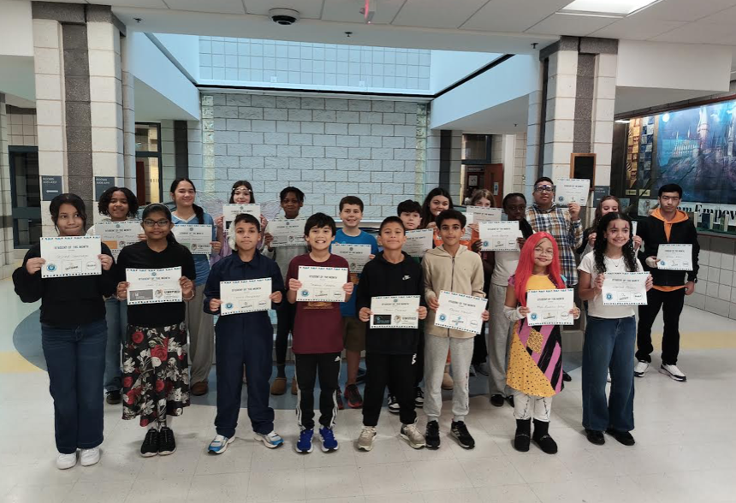

Slide 3




Rayden Acevedo-Rosado
Jacob Gonzalez
Sammy Fabello

Slide 4

Rayan Nadiff
Skylah Santiago
Mia Rosario Ortiz

Slide 5




Lucas Gonzalez
Delilah Milano
Anna Oppong

Slide 6




Maria Malave
Adryan Gomez
Elham Azimi

Slide 7


Norielys Guerra
Isabella Seely

Slide 8


